Slide 1
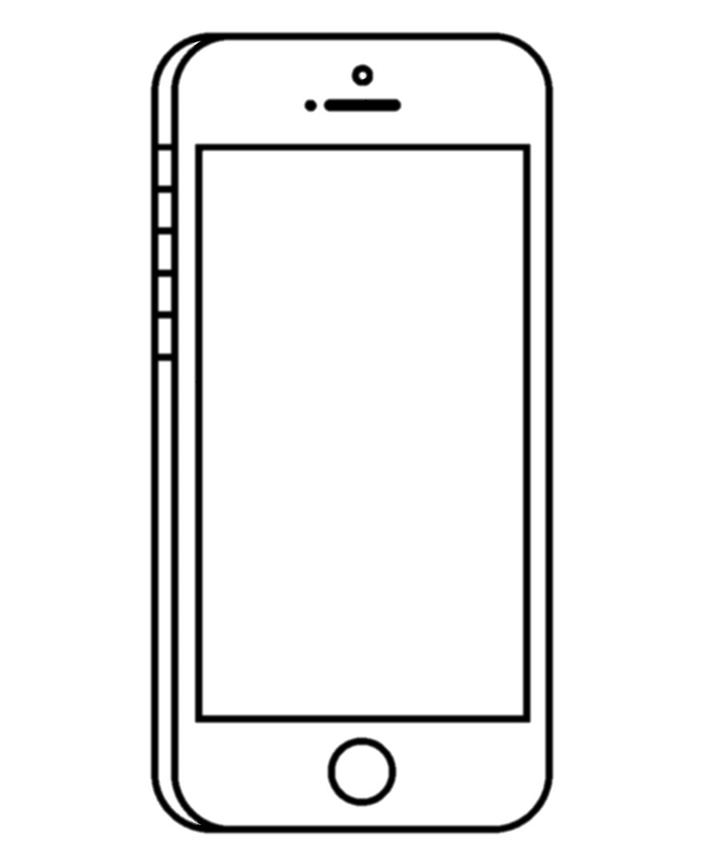





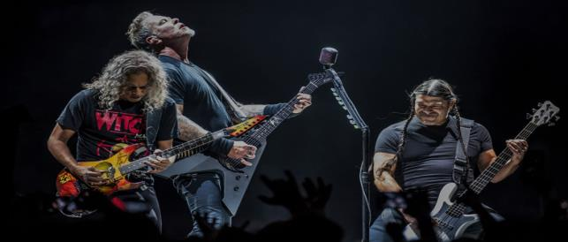

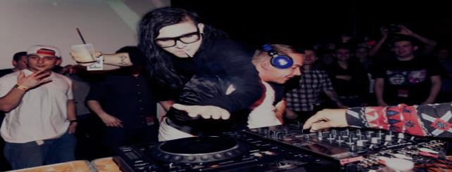



What kind of music do you like? Pick at least 3.
JAZZ
Crescendo
Make it Loud!
Email
ROCK
Crescendo
Make it Loud!
Password
Forgot Password?
POP
LOGIN
or
DUBSTEP
don’t have an account? register now!

Slide 2
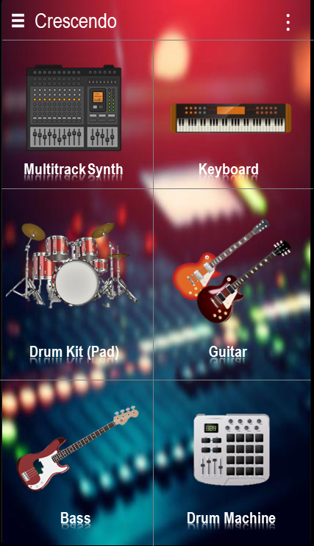

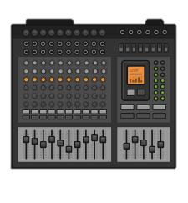

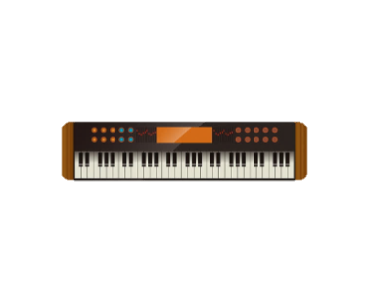


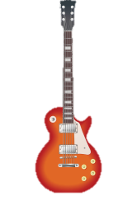
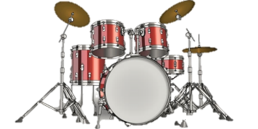

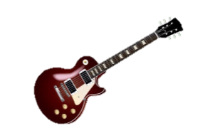


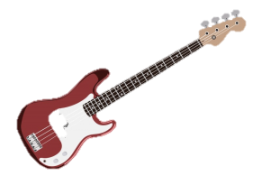
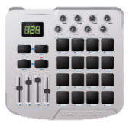

Crescendo
⋮
Crescendo
⋮
Music Zone
Record Files
Multitrack Synth
Keyboard
Sound Plugins
Multitrack Synth
Keyboard
Update Required
The app is outdated. Please, update it to the latest version.
MIDI Keyboard
Cancel
Update
Remove ADs
Drum Kit (Pad)
Guitar
Settings
Drum Kit (Pad)
Guitar
About
Bass
Drum Machine
Bass
Drum Machine

Slide 3
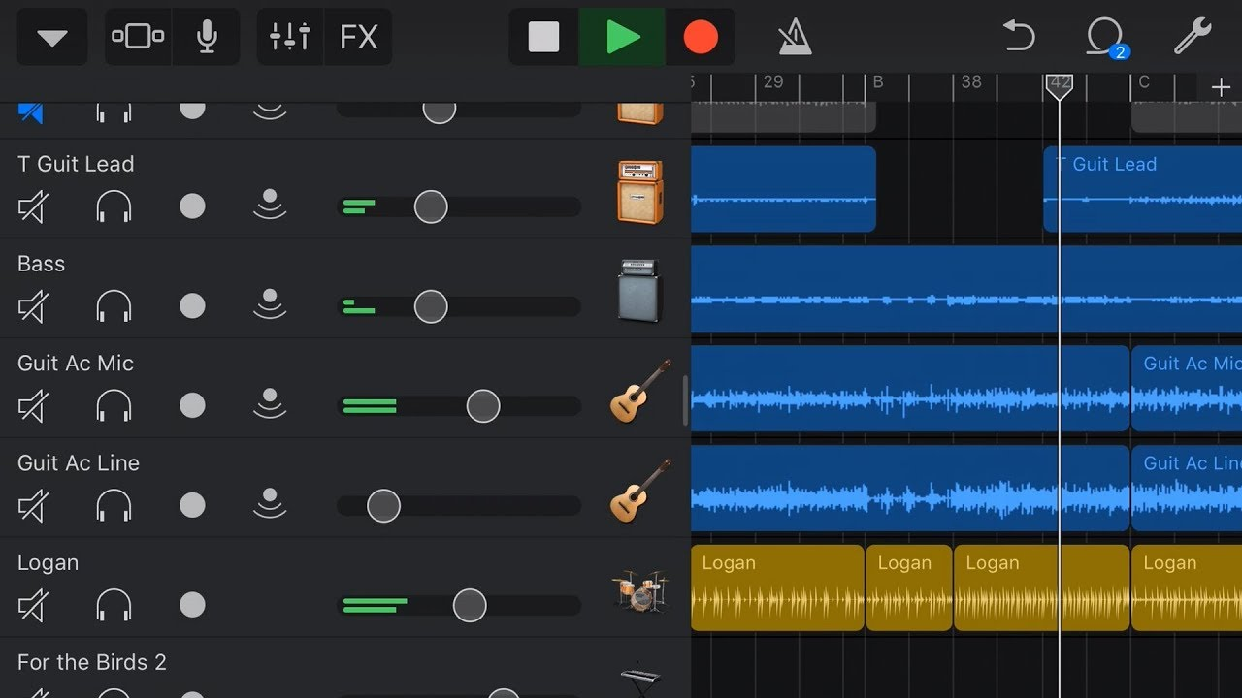
⋮
“Crescendo” Would Like to Access the Microphone
Enable microphone access to record your voice and more.
OK
Don’t Allow

Slide 4

⋮
Crescendo
Make it Loud!
Full Name
Date of Birth
Mobile Number
Username
Email
Password
Confirm Password
Gender
Register

